Slide 1
Multivariate Bookdown
Ju-Chi Yu
Brainhack Dallas 2019
Nov. 16-17

Slide 2
Goal
In the long run:
provide an introduction of simple and advanced multivariate techniques
These two days:
PCA introduction
PCA example with R code
Maybe SVD

Slide 3
Tools
R/Rstudio (bookdown)
GitHub
(RM3 - multivariate analysis)
Packages:
Analysis: ExPosition
Plotting results: ggplot2, and PTCA4CATA

Slide 4
What do I have now?
Three .rmd files for Bookdown on GitHub
PCA introduction
What I have from what I have in my literature review (more math)
Cookbook template we give to students in RM3 (include plots and code, but no math)
PCA example
Example code in the cookbook template
SVD
The core techniques of all multivariate methods
Not sure to include it or not

Slide 5
How can you help?
If you know some PCA,…
When do you usually open a tutorial or your old cookbook
How can we organize the content to help with your search
Writing the descriptions (in LaTeX)
Make images
Add descriptions for images
Add more instructions for each function we are using (to analyze or to plot)

Slide 6
How can you help?
Can I help if I don’t know or am not familiar with PCA?
Yes!
Help us create a template
What are you expecting when you search for a PCA tutorial
How can we make the bookdown so that it’s easier for people to apply PCA to their analyses
You will be the best reviewer for our writing

Slide 7
Plans for this Brainhack
Day 1 (11:00 am – 12:30 pm):
Meet up
Discuss the outline of the bookdown
Go through materials I have on GitHub
Discuss how we can do this
Find things you’d like to work on

Slide 8
Plans for this Brainhack
Day 1 (3:30 pm – 5:00 pm):
Meet new people
Another discussion about the outline if needed
Work in two groups
Familiar with PCA
Plots
.rmd script
Not familiar with PCA
PCA introduction
Give feedbacks on figures
Other…

Slide 9
Plans for this brainhack
Day 2 (10:30 am – 12:30 pm):
Meet up
Discussion about progress on Day 1
Work in two groups (11:00 am)
Familiar with PCA
Plots
.rmd script
Not familiar with PCA
PCA introduction
Give feedbacks on figures
(11:30 crash course for epPCA and PTCA4CATA)

Slide 10
Plans for this brainhack
Day 2 (1:30 pm – 2:45 pm):
Finalize what we are left with
Before 3 pm:
Create final presentation

Slide 11
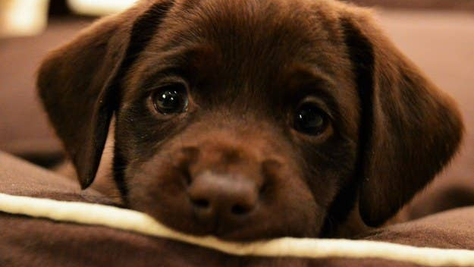
Please join us!
Questions?

